Slide 1
Multi-Tenant Splunk
Steven Bochniewicz
Pitfalls from the Pit
October 2022 | Version 2.0

Slide 2
Speakers
Steven Bochniewicz
Sr. Security Architect

Slide 3
Building on the work of others
Daniel Daily, Splunk Administrator, Indiana University
Allen Tucker, Manager, HELPnet Technology Services, Indiana University
http://conf.splunk.com/sessions/2016-sessions.html#search=Daniel%20Daily
Cary Peterborg, Sr. Monitoring Engineer, LDS Church
https://conf.splunk.com/session/2015/conf2015_CPetterborg_LDS_Church_SimplifiedForwarderDeploymentand_FINAL.pdf Sabina Lea, Splunking with Multiple Personalities, Splunk https://conf.splunk.com/files/2017/slides/splunking-with-multiple-personalities-extending-role-based-access-control-to-achieve-fine-grain-security-of-your-data.pdf
Jeff Champagne, Index Impasse: Limiting Data Access on a Per Event Basis, Splunk
https://conf.splunk.com/files/2019/slides/FN1081.pdf

Slide 4
Splunk as Service
Centralized managed splunk for
Decentralized IT services
Potential 122 department it customers sharing one splunk enterprise infrastructure
Notes:
This is the GOAL. Live the dream!

Slide 5
SplunkBase
Friend or Foe?
SplunkBase just like Splunk not designed for Multi-Tenant
Many apps have searches and other lookups that will run as system which will run with access to all indexes
These apps are a great starting point for views and dashboards
Watch out for lookups, static index definitions, and saved searches
Apps that can provide CIM mapping and other field extractions are a great

Slide 6
What we have done
Automate all the things:
AWS through CloudFormation/Puppet - Index creation
Templated search head apps - new departments
ClientName (deploymentclient.conf) - department specific technical addons
Notes:
Created automation to allow us to add new indexes from our AWS expansion (CloudFormation/Puppet)
Automated the onboarding of departments by templated search head apps.
Using ClientName (deploymentclient.conf) to help the automated deployment of department specific splunk apps
Create department level default indexes to ensure that their data if not properly configured still goes into an index their department can see.

Slide 7
What we have done continued...
Naming Convention:
All Indexes, Apps, Roles…
Division_Department_(SubDepartment)_
Not managing role mappings in splunk (too much configure too little time)
Custom apps for each department
Separate Read and Write Roles
Separate Index roles
Index wildcard
Create custom privilege roles for issue access to commands and features
Notes:
Created a naming convention for all indexes, apps and roles.
Division_Department_(SubDepartment)_
Using Shibboleth we assert the splunk roles directly this prevents having to maintain the group/role mapping
Each app has both a read and read/write role which allows us to control at the group level who is accessing and changing the apps.
Each department has an index role that includes their default wildcard index (this allows the creation of new indexes to be decentralized from the access granting.
Power roles are used to control the level of access granted.

Slide 8


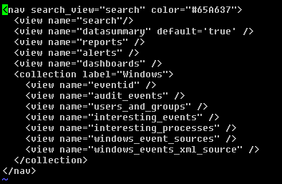
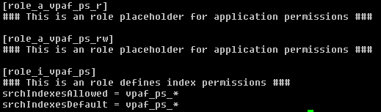
Department Apps
Example Settings
user-prefs.conf
default.xml - data/ui/nav
default.meta
authorize.conf

Slide 9
Search App - not your friend!
Cannot be disabled
Since by default all users need access to search app for Splunk functions/commands this is a common path where users can breach data
Hide the Search app
If you don’t users might accidently store searches/alerts or dashboards in them
Notes:
Hide the Search App. (You cannot disable this app unfortunately too many splunk functions reside in this app. If you do not hide this app you could have some users accidently store searches/alerts or dashboards in them.
Make sure the default behavior of all your searches is runasuser (list config settings) This will prevent accidental data loss from searches search more broadly
Limit rights of users to perform scheduled searches (these searches only run as owner and can be a risk for data loss. Ensure your user base who has these privileges knows the risks when they scheduled a saved search.

Slide 10
Dashboards
Use the work of other apps
Include dashboard and views from a Managed App for quick changes to common dashboards
Directly include another view(dashboard) in an apps nav menu

Slide 11
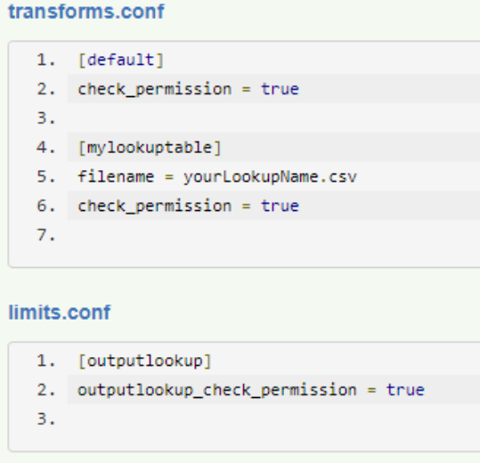
Lookups - Friend or Breacher
Lookups can be great source to summarize data and provide quick access
However many apps have savedsearches that build lookups will run as system and thus collect more data then potentially intended.
Create service account or assign these savedsearches to run as a user with the limited access, or modify the base search to only include the restricted indexes.
By default Splunk does not verify permissions before writing to a lookup file, and power users have the write to create and modify lookups.
Notes:
check_permission = <bool>
* Specifies whether the system can verify that a user has write permission to a
lookup file when that user uses the outputlookup command to modify that file.
If the user does not have write permissions, the system prevents the
modification.
* The check_permission setting is only respected when output_check_permission
is set to "true" in limits.conf.
* You can set lookup table file permissions in the .meta file for each lookup
file, or through the Lookup Table Files page in Settings. By default, only
users who have the admin or power role can write to a shared CSV lookup file.
* This setting applies only to CSV lookup configurations.
* Default: false

Slide 12
Scheduled / Saved Searches
Saved searches by default run as Owner
Configurable per search
Can be forced to always run as user
Allows you to override a user limitation with search indexes, however if left unmonitored could lead to data loss
Scheduled Searches always run as owner
Remove the ability to schedule searches from the default User Role
Limit rights of users to perform scheduled searches
Since these searches only run as owner.
savedsearches.conf - [default] or per search stanza
dispatchAs = [user|owner]
* This setting is only meaningful for shared saved searches.
* When dispatched as "user", the search is run as if the requesting user owned
the search.
* When dispatched as "owner", the search is run as if the owner of the search
dispatched the search, no matter which user requested it.
* If the 'force_saved_search_dispatch_as_user' setting, in the limits.conf
file, is set to "true", then the 'dispatchAs' setting is reset to "user" while
the saved search is dispatching.

Slide 13
Authorize.conf Features
srchFilter
Should review the referenced talk about diving to deep into this.
Ability to provide event event restrictions with many exceptions
Only works when all user role have been explicitly planned.
Only use index extractions as any user with ability to create knowledge objects can add fields to expose restricted events.
Always explicitly exclude items we want to prevent users from seeing.
srchIndexesDisallowed
allows you to explicitly prevent specific indexes
good for exclusion roles to prevent users access to sensitive

Slide 14
Workload Management - admission rules 8.1
Admission rules to prevent running
rogue searches
such as poorly written
potentially harmful searches
some users running searches during certain times of the day
Prevent excessive amount of system resources or interfere with critical search workloads
https://docs.splunk.com/Documentation/Splunk/latest/Workloads/AdmissionRules

Slide 15
Risky Commands 9.0
Custom commands set is_risky to in the commands.conf stanza to require only users authorized with custom_commands capabilities enabled
Additionally now dashboards and searches with risky commands will prompt the user prior to running to inform them and explicitly authorize them running
In 9.0 and newer a feature to limit the ability to trigger certain commands, collect, dump, delete,fit, outputcsv, outputlookup, run, runshellscript, script, sendalert, sendemail, tscollect
New capabilities for roles several are added by default
https://docs.splunk.com/Documentation/Splunk/latest/Security/SPLsafeguards

Slide 16
Field Based Filtering - 9.0
Ability to modify the value for a field based on the roles of a user
Add filters to authorize.conf
fieldFilterLimit = [sourcetype::<sourcetype>|host::<host>|source::<source>]
fieldFilterLimit does not support wildcard or operators, ensure
Limited to 1 fieldFilterLimit per role, you can add many roles to a user for the purpose of all filters needed
fieldFilters are imported by roles by hierarchy, from left to right.
To Enable add role_based_field_filtering=true in [search] stanza in limits.conf
https://docs.splunk.com/Documentation/Splunk/9.0.1/Security/planfieldfiltering

Slide 17
Field Filtering - 9.0 continued
fieldFilter-<fieldname> = <option>
_raw only supports regex replacement via SED
when the using a field you can choose from
NULL, <string replacement>, SHA256, SHA512
If you need to do downstream calculations I strongly encourage SHA512 as it is a unique hash that will equal the value of the value without exposing the value
Limitations
Doesn’t filter generating commands like inputcsv
Restricted commands bypass filters, mpreview, mstats,tstats, typeahead, walklex
run_commands_ignoring_field_filter capability allows users to run commands that bypass field filters
https://docs.splunk.com/Documentation/Splunk/9.0.1/Security/setfieldfiltering

Slide 18
Forwarders
You can’t control what you can’t control
Create templates of common apps and collections
Windows App
*NIX App
Limit the amount of ability users configure forwarders
Cannot control what the forwarders will send
If the users manage their own inputs they can send whatever they want to any index.
8.1 added Support for UF to send data via HEC
Increased client level security
Client Token Auth
Index control

Slide 19
Questions?
Steven Bochniewicz
@Stboch Slack User Group

